Slide 1

Competitive Programming From Problem 2 Solution in O(1)
P
T
H
I
N
K
F
A
S
T
S
What else to learn?
Mostafa Saad Ibrahim
PhD Student @ Simon Fraser University

Slide 2
Before Learning More
Make sure to read from a book the corresponding chapters of what you learned
E.g. A first book of C++
Solve much exercises
Do many projects
E.g. Faculty Project, Ask.fm, Facebook => Console apps
Optionally, but highly advised, share in programming competitions. See.

Slide 3
Learning More
We can think in further 2 stages (after prog 1)
Stage 2: Further programming concepts that are important to learn
Stage 3: If and only if you plan to use C++ as your major language in market
Note, C++ has less market share in arabian countries
Java, C#, Python have bigger market share

Slide 4
Major Concepts

Slide 5
Object Oriented Programming
We referred before to structures and classes
Our Educational system is good base for learning OOP
Object = Data + Methods
Circle Object = (Center, Radius) + Area(), Draw()
How to think in the world in terms of objects
How to define relationships between them
Circle, Rectangle are Shapes who have area()
Building OOP skill is so important for a software engineer….do many projects...ask some TA to give feedback

Slide 6
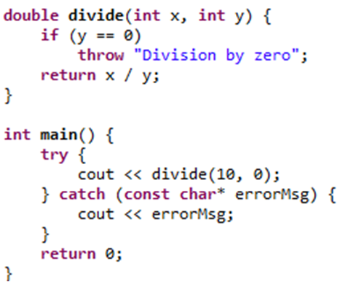
Exception Handling
We need to catch/propagate mistakes!

Slide 7
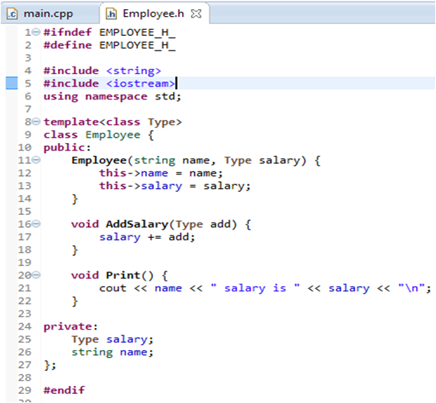
Template Programming
Things
Can
Be
More
Generic!
..
vector<int>
vector<double>
Same code!

Slide 8
Concurrency
Major concept to learn...tough in practice!
Imagine a 1000x1000 array to sum its content
Assume reading element and adding it takes x ms. Then Total time is ~ x * 10^6 ms
What if we can do parallel processing?
E.g. someone sum first row, on same time other one sum second row, etc
If we can run 100 parallel code, our time ~x * 10^4 ms
#include<thread> in c++11

Slide 9
C++11
We described small features in C++, but there are more
Also, check C++11 for OOP staff
Check new coming releases of C++ too

Slide 10
Going Deeper

Slide 11
Make Libraries
We used before C++ Standard Library and C++ Standard Template Library
Someone implemented that for us :)
What if you want to make library of your work to install and use by others?
Imagine you coded a fast function to do matrix multiplication and want others to use
Libraries: Static - Shared

Slide 12
Use Libraries
We also need to use other people's libraries
One of the major libraries to learn is the boost library
Armadillo / Eigen are popular math libraries
Download Armadillo, try to build it and use it.
Use Libs to parse text formats (XML, JSON)
And more libraries
Configure eclipse? See 1. See 2.

Slide 13
Makefile
Managing compilation of C++ project is easy
But when project is really big, we need more professional way
Make tool is a program to read some text files (makefiles) that tell us how to build the project, in which order and use what
To build a makefile, use command make
Nice starting tutorial
More: Learn cmake

Slide 14
Profiling
Say you run your program, but found overall is very slow. Code is big to analyze manually
Or you have memory leaks and want to get report on memory consumption of functions?
What if some program can run test case and give us time estimate of every function?
Profiling is dynamic program analysis
Static analyser checks code without running code
Valgrind's Tool Suite are great on linux

Slide 15
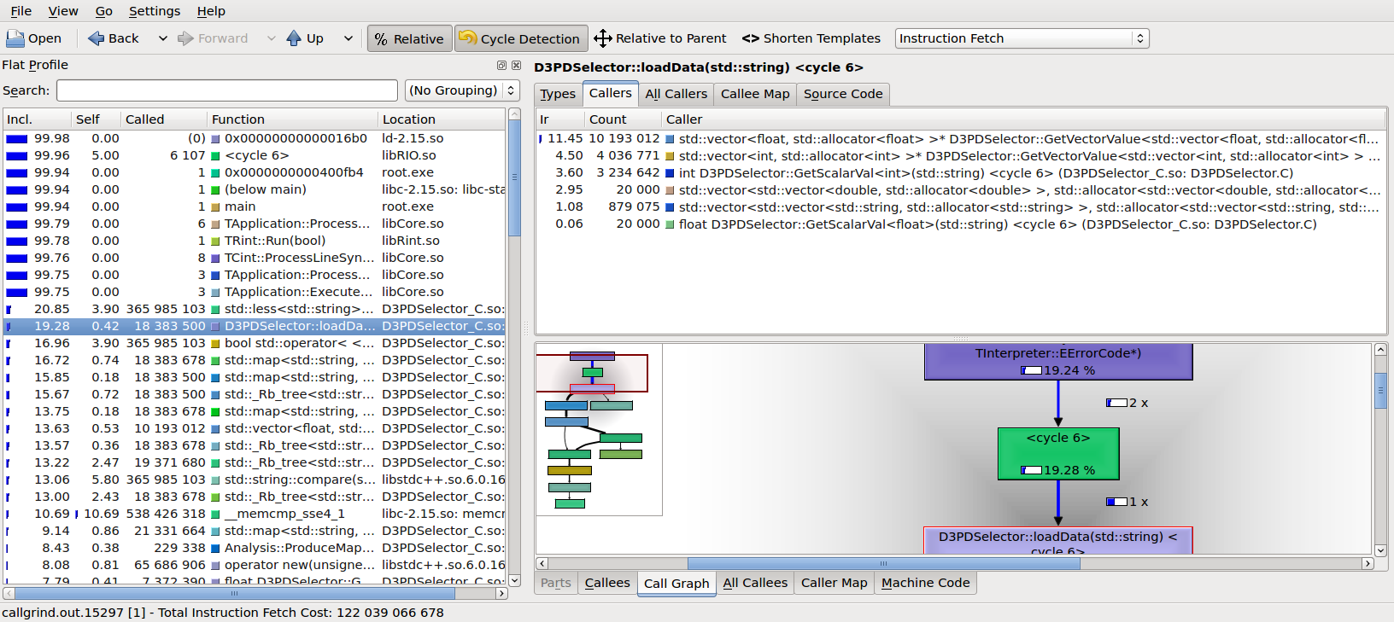
Profiling Example(kcachegrind)
Notes:
Src https://wiki.physik.uni-muenchen.de/etp/images/3/3e/Kcachegrind.png

Slide 16
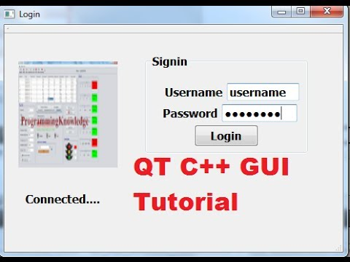
C++ QT
QT is a framework that uses C++ and add some extension for it
It can be used for GUI and server applications
It is not so wide in usage. But used in some popular apps.
Notes:
Src: http://i.ytimg.com/vi/nZ9Mejld2lI/hqdefault.jpg

Slide 17
Professional Development
We can write Spaghetti code...or be professional
To write professional code, read/practice it :)
E.g. Generally, read “Clean Code” book
E.g. In C++, see Scott Meyers Effective C++ books
Follow writing style
Read Open Source Projects
Sharing in Google Summer of code is nice

Slide 18
Related points
Windows Programming
Internationalization and localization
Serialization
Networking (e.g. chat program) course
Distributed Computing course
Licenses (non tech): E.g. GPL, Boost
Going low for faster processing
Low: Using Inline Assembly in C/C++
Very Low: Using SSE Instructions

Slide 19
تم بحمد الله
علمكم الله ما ينفعكم
ونفعكم بما تعلمتم
وزادكم علماً

